Slide 1
Celebrity detection using AWS Rekognition
By Benjamin sklar June 2017

Slide 2
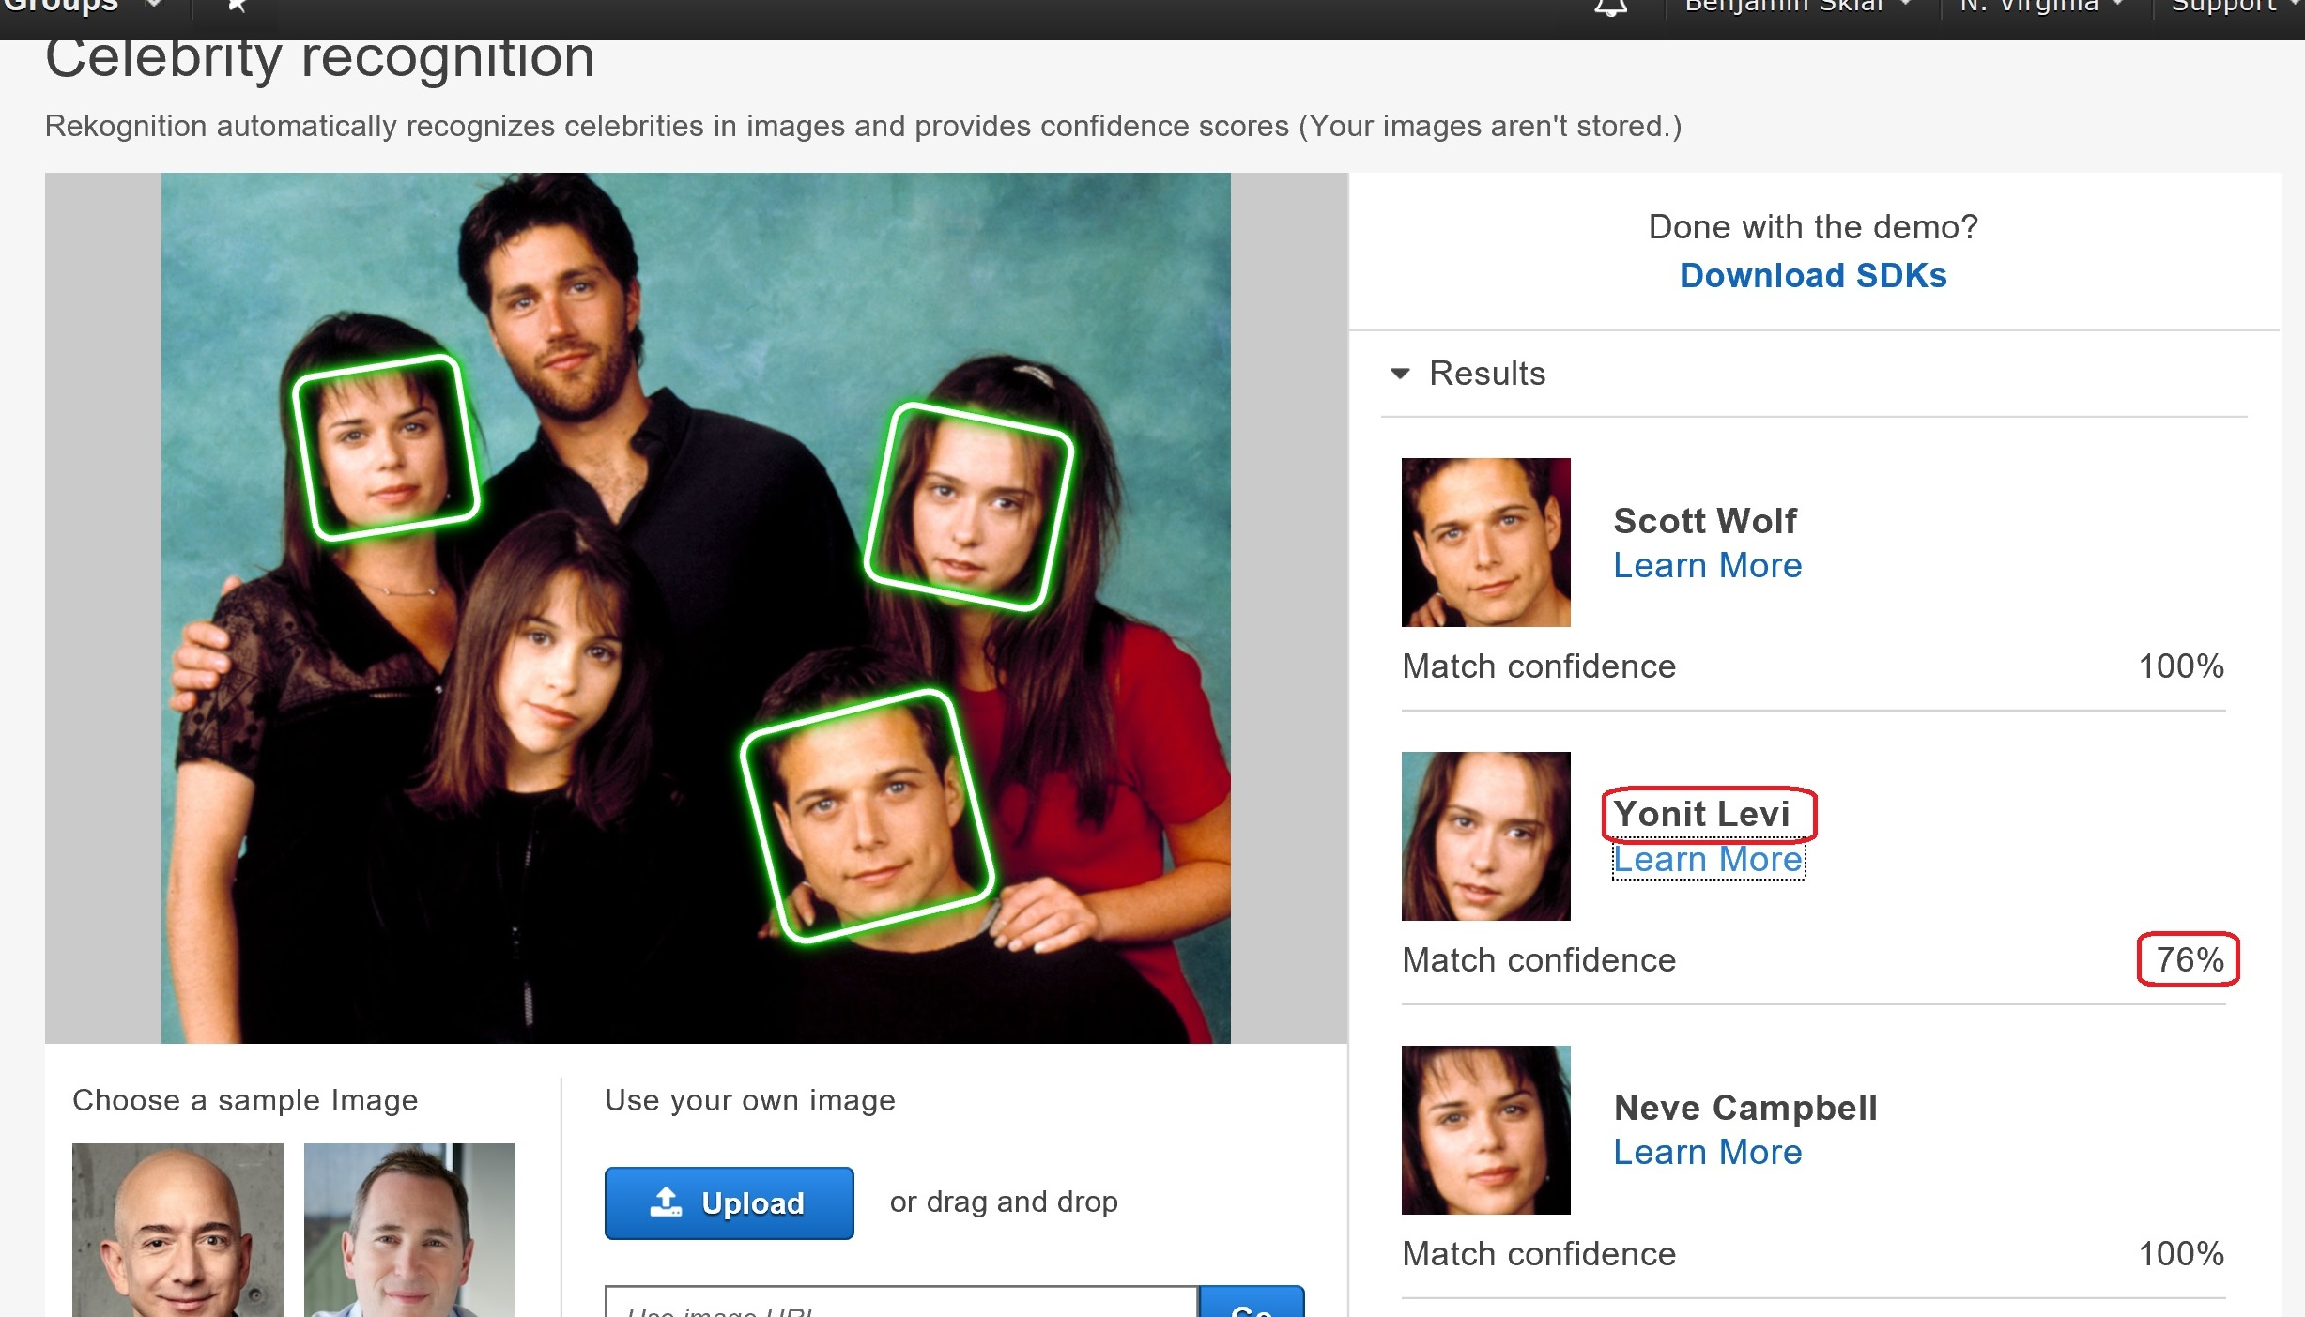
Rekognition Celebrity recogntion
recognizeCelebrities API does facial recognition and compares faces with AWS’s celebrity face-collection (provides Name and imdb.com url)

Slide 3
ToDO
Write API Gateway & Lambda function to upload new images; Take URL or local file, validate as JPG or PNG image, detect height & width, upload to S3 bucket, put new entry into CelebrityImageFiles table. (Write webpage to use this)
Update webpages allimages.html and image.html into files.html
Limit IAM roles to least-privilege-needed
On website show bounding boxes where appropriate
Make use of Rekognition API recognizeCelebrities in lambda function trigCelebrityFaces

Slide 4
Links
Website: http://benjaminsklar-celebrity-images.s3-website-us-east-1.amazonaws.com
Source: https://github.com/brskl/Cloud230B_final
AWS Documentation: https://aws.amazon.com/rekognition/

